Slide 1



INDIAN INSTITUTE OF TECHNOLOGY GUWAHATI
Kinematics of Machinery
ME224
Course Project on Combined Harvester
Project Team Members
Vasanth P (230103112)
Vatsalya Singh (230103114)
Vaibhav Kumar (230103108)
Subhodeep Paul (230103100)
Ajay Pratap Singh (230103132)

Slide 2
INDEX
Introduction of Combined harvester
Assembled Product
Working Demonstration of the harvestor
Wing Support Frame
Introduction
Working and it’s Applications
Auger and Reel
Introduction
Working and it’s Applications
Cutter Bar
Introduction
Working and it’s Applications
Conveyor Belt
Introduction
Working and it’s Applications
8. Threshing Cylinder
Introduction
Working and it’s Applications
9. Large Cleaning Shoe Area
Introduction
Description of Parts
10. Spreader
Introduction
Working and it’s Applications
11. Grain Separators
Introduction
Working and it’s Applications
12. Grain Separator Frame
Introduction
Working and it’s Applications

Slide 3
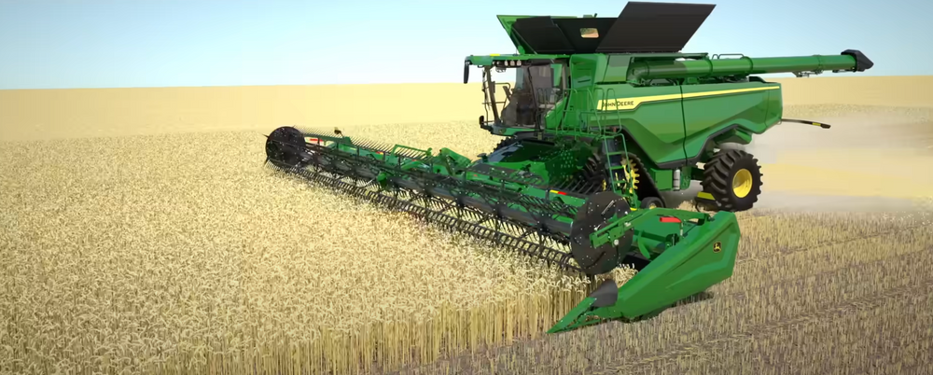
Combined Harvester
The combined harvester is one of the most significant innovations in modern agriculture. It revolutionized the way crops are harvested by merging multiple processes into a single operation. This machine is widely used in both small and large-scale farming. It improves productivity, reduces costs, and minimizes crop losses. As a result, it has become an indispensable tool for farmers across the world.
Multi-function Machine : Performs reaping, threshing, and winnowing in a single process, making harvesting faster and more efficient.
Time and Labor Saving : Reduces the need for manual labor and significantly cuts down harvesting time.
Efficient Grain Processing : Cuts the crop, separates the grain from the stalk, and cleans it while moving across the field.
Advanced Technology Integration : Modern versions include GPS, sensors, and yield monitoring for precision agriculture.

Slide 4
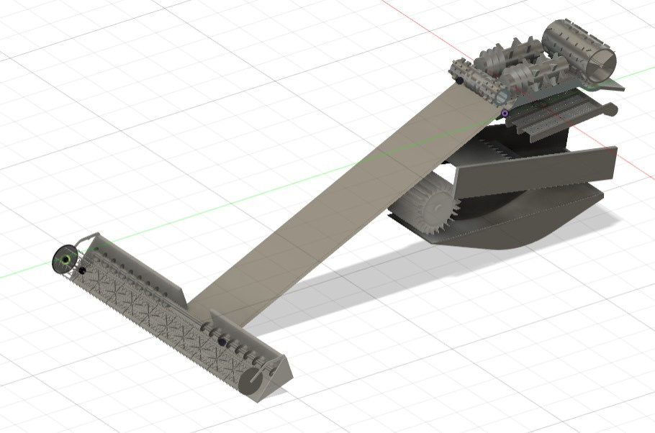
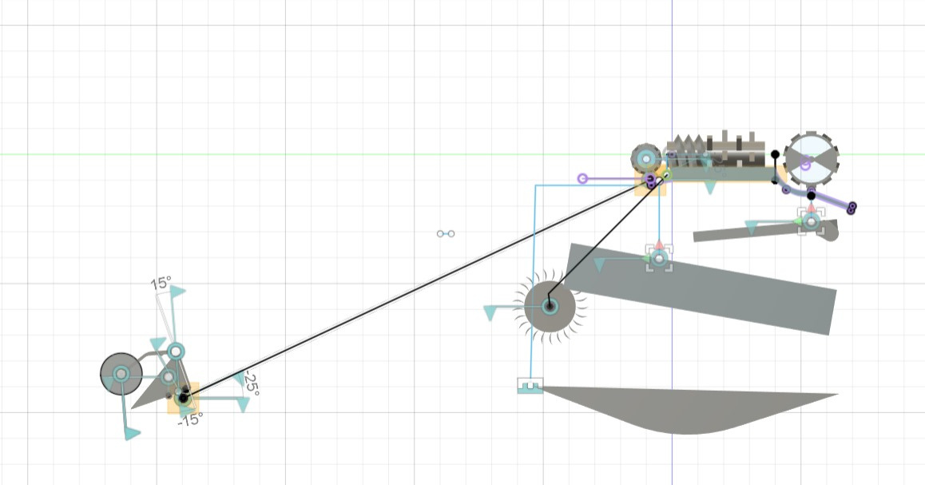
Assembled Product
Side View
Home View

Slide 5
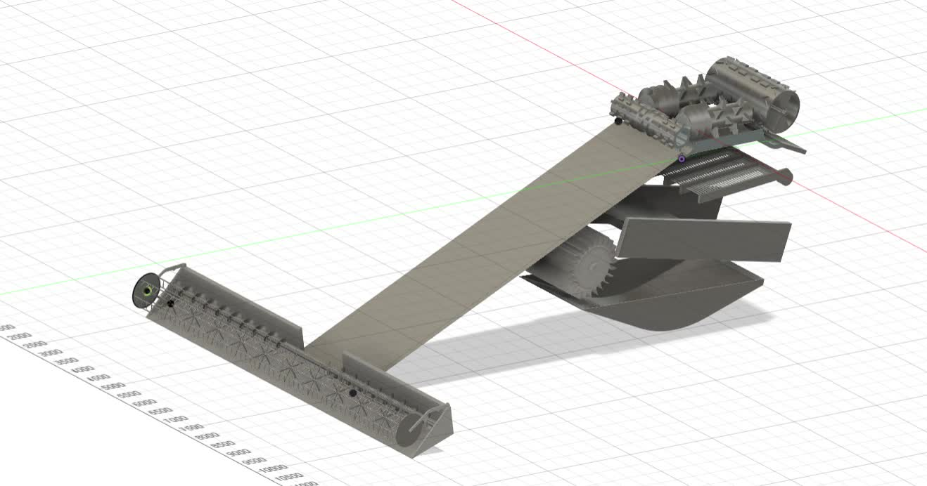
Working Demonstration of the harvester

Slide 6
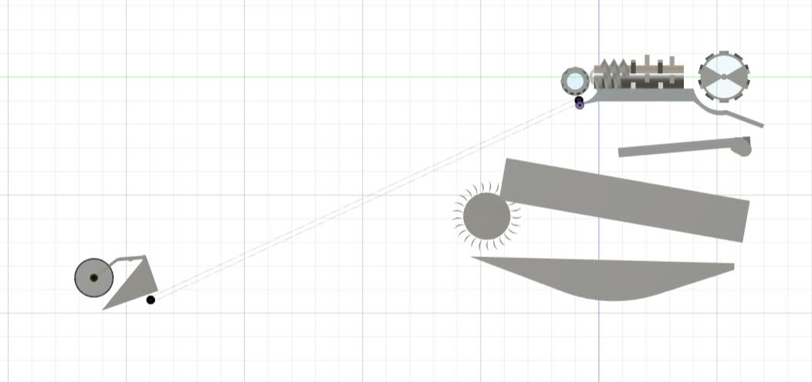
Working Demonstration of the harvester

Slide 7
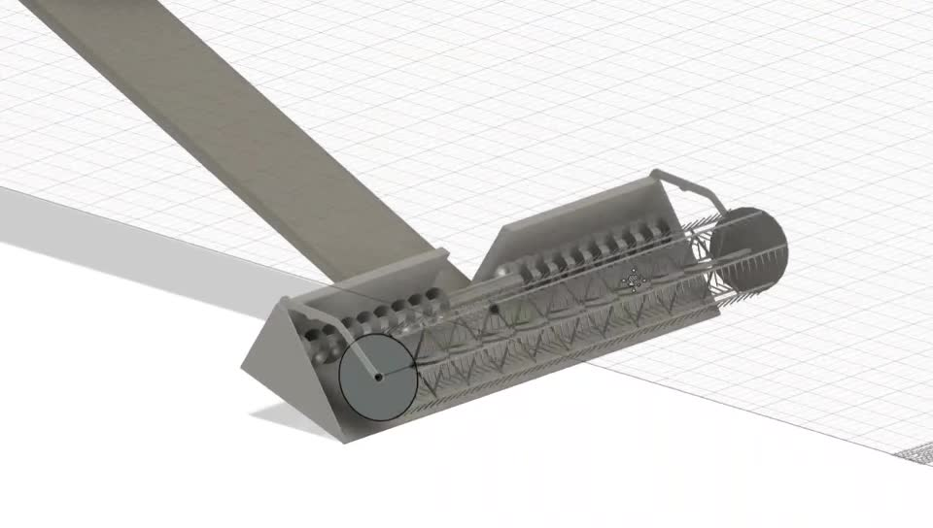
Working Demonstration of the harvester

Slide 8
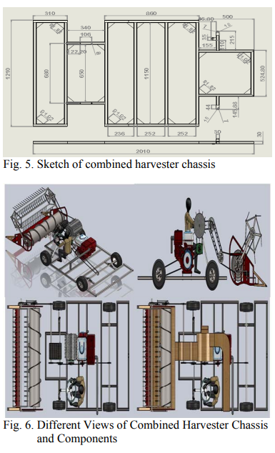
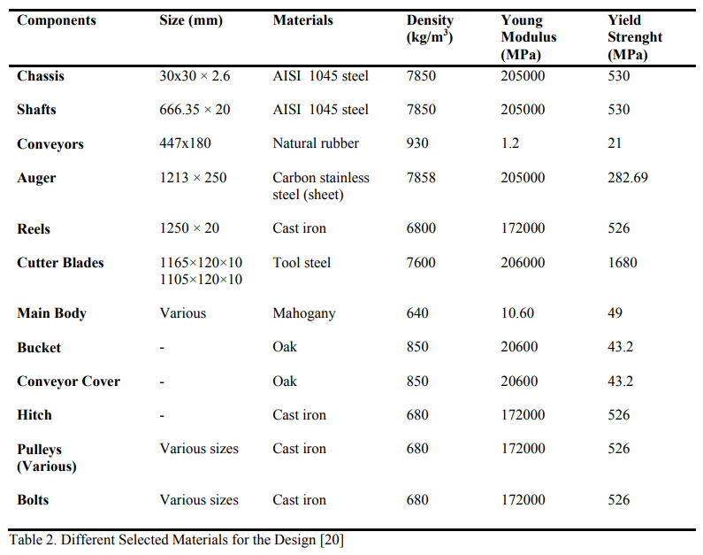

Slide 9
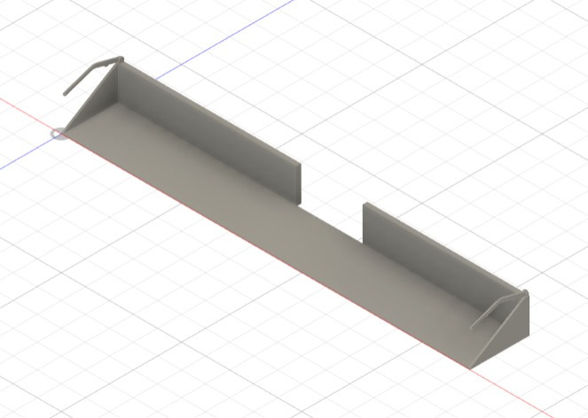
Wing Support Frame
The Wing Support Frame is a robust structural part located at the joint between the center header and its side wings on a folding draper header.
Built from high-strength steel, it provides the mechanical integrity required to support the wide and heavy wing sections during harvesting and transport.
It works in coordination with hydraulic and locking systems to ensure safe deployment and retraction. Designed to handle continuous stress, it enables high-performance harvesting even on uneven terrains by maintaining wing stability and alignment.

Slide 10
Working and Application
Wing Support Frames are essential in modern combined harvesters using large folding headers. They allow for efficient transport through narrow roads by enabling wing folding and ensure header stability in wide-field harvesting. These frames help maintain crop intake consistency by preventing wing misalignment. Their role is structural but vital for header functionality, especially in large-scale farming operations.
Working of wing support Frame
Supports wing sections of the draper header during both folding and field operations.
Connects to central chassis with hinge joints allowing smooth pivot motion.
Integrates hydraulic cylinders to power the folding/unfolding of header wings.
Uses locking pins or latches to secure the wings firmly during operation.
Absorbs vibration and field stress through durable mounts and materials.
Ensures proper alignment of header components to optimize crop intake

Slide 11
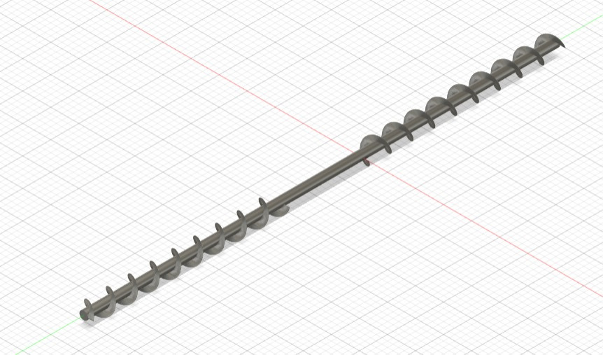
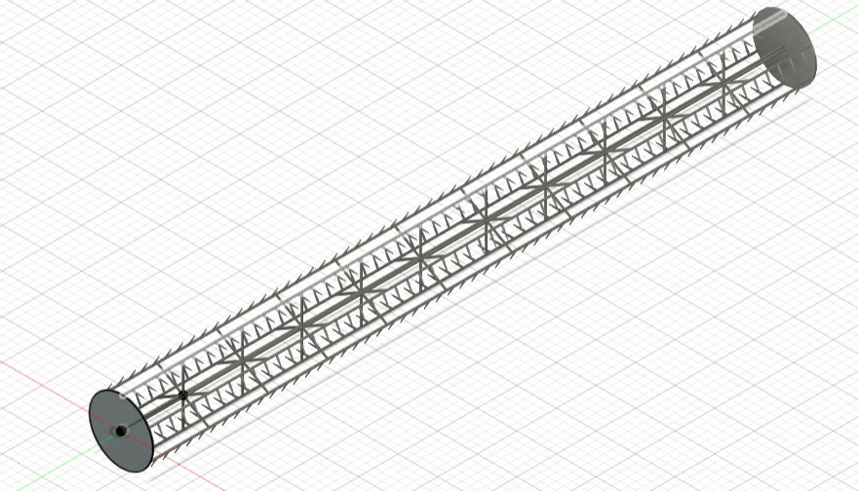
Auger and Reel
The reel and auger are critical front-end components of the combine harvester's header. The reel, with rotating tines or bats, gently lifts and guides crop plants toward the cutter bar.
Just behind the cutter bar, the auger (a large horizontal rotating shaft with spiral flights) collects the cut crop and channels it toward the feeder house.
Both parts work in precise synchronization to ensure smooth, continuous crop feeding. Made from high-strength, weather-resistant materials, they’re engineered for maximum performance across different crops and field conditions.

Slide 12
Working and Application
Reels and augers are essential in harvesting cereals like wheat, barley, and oats. They enable even crop flow, reduce feeding losses, and prevent crop tangling or bunching at the cutter bar. Especially in lodged or uneven crops, the reel lifts the plants for effective cutting. The auger then transports the material efficiently into the processing section of the harvester.
Working of Auger and Reel
Reel rotates to sweep standing crop toward the cutter bar.
Tines or bats on the reel guide and lift crop evenly, including lodged plants.
Cut crop drops onto the platform where the auger picks it up.
Auger flights rotate to move crop laterally toward the center of the header.
Center fingers or paddles push material into the feeder house
opening.
Ensures constant crop flow for uninterrupted threshing and separation.

Slide 13
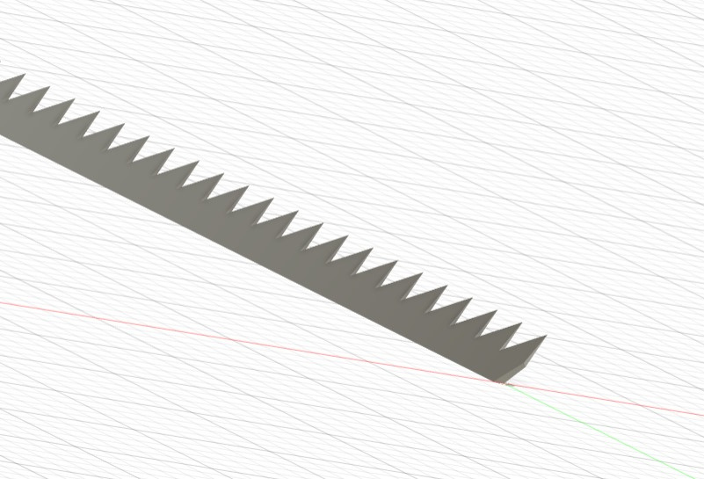
Cutterbar
The cutterbar is one of the primary components of a combine harvester, responsible for the initial cutting of crops at their base. Positioned at the front of the machine, it consists of a reciprocating knife mechanism that works against stationary fingers to slice through plant stems. It spans the width of the header and is driven by a mechanical or hydraulic system to achieve a consistent, high-speed cutting action.
Cutterbars are built from hardened steel and often include guards to prevent clogging and improve safety. A well-maintained cutterbar ensures clean, even cutting and minimal loss of grain or stalk. It is an essential element in reducing operational losses during harvesting.`

Slide 14
Working and Applications
The cutterbar’s application lies in cleanly and efficiently cutting standing crops and delivering them to the reel and conveyor for further processing. It is vital for achieving uniform crop height, minimizing grain loss, and maximizing harvesting efficiency. Cutterbars are adaptable to different field conditions and crop types, making them essential in mechanized farming.
Working of the cutterbar :
Receives power from the harvester's drive system to actuate its blades.
Reciprocating knife sections move back and forth between guard fingers.
The sharp knife edges slice through the stems of standing crops.
Cut crops fall backward into the conveyor zone for further processing.
Protective guards prevent clogging and guide the crop into the blades.
Adjustable height allows optimization for different crop types and field conditions.

Slide 15
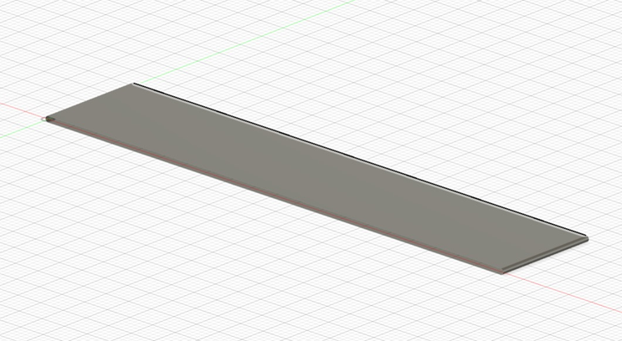
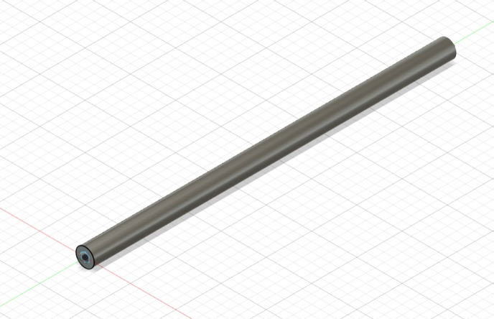
Conveyor Belt
The conveyor in a combined harvester is a crucial transmission component designed to transport harvested crops from the front end to the threshing cylinder. It consists of a chain-and-slat or belt mechanism that moves the crop material smoothly and continuously.
The conveyor is usually enclosed within a tunnel-like structure for safety and efficiency. Built with strong, wear-resistant materials, it is engineered to handle large volumes without jamming. It acts as a bridge between harvesting and threshing sections.
The efficiency of the conveyor system directly influences the throughput and operational speed of the harvester.

Slide 16
Working and Applications
The conveyor’s primary application is to transfer the crop cut by the cutterbar and collected by the reel to the threshing cylinder for grain separation. It helps in maintaining a continuous flow of harvested material while preventing accumulation or blockages. A well-designed conveyor improves operational speed and reduces crop damage during transfer. It functions under various field conditions and is adaptable to different crop types.
Working of the conveyor belt :
Receives cut crop from the feeder mechanism at the front of the harvester.
Uses a chain or belt system to move material upward toward the threshing cylinder.
Crop remains compacted and aligned during transfer to ensure efficient threshing.
Operates synchronously with other harvester systems to avoid overloading.
Frame and slats are made of durable materials to handle abrasive or moist crops.
Ensures consistent crop delivery, reducing idle time and boosting overall output.

Slide 17
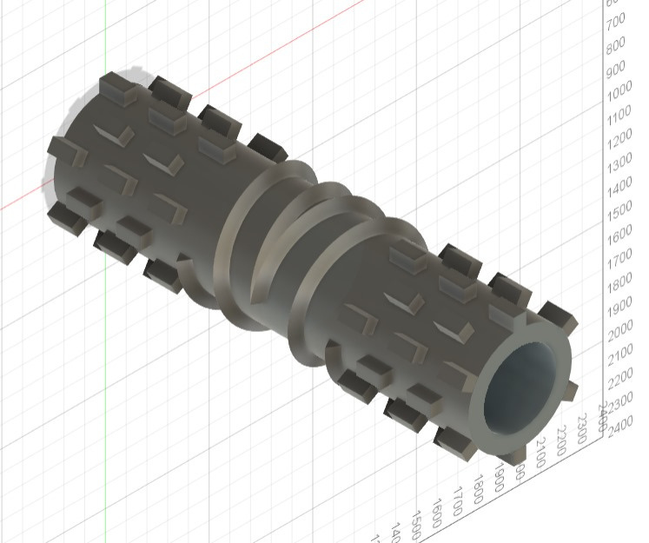
Threshing Cylinder
The threshing cylinder is a central component in a combined harvester, primarily responsible for separating grains from the harvested crop material. It is generally cylindrical in shape and fitted with rasp bars or spikes along its surface.
This rotating drum works closely with a concave beneath it to create the threshing action. The material is fed between the cylinder and the concave, where it is rubbed and impacted to detach grains from husks or straw.
Threshing cylinders are typically made of high-strength steel to resist abrasion and wear. The surface may be hardened or coated for longer life.
Its speed and clearance from the concave are adjustable depending on crop type and condition. This component is vital for efficient crop processing and minimal grain loss.

Slide 18
Working and Applications
The threshing cylinder is used to separate grain kernels from the crop material through mechanical impact and friction. It is essential for ensuring clean grain separation, minimizing grain breakage, and reducing the workload on subsequent cleaning units. Its performance directly affects the quality and yield of the harvest. The design and speed must be optimized for different crops such as wheat, rice, or maize.
Working of the threshing cylinder :
Crop is fed between the rotating cylinder and the fixed concave.
Rasp bars on the cylinder strike and rub the crop to dislodge the grain.
Grain falls through the openings in the concave while straw moves forward.
Speed of the cylinder and concave clearance are adjusted to crop type and condition.
Heavy-duty bearings and a drive mechanism ensure smooth rotation and handling of load.
Threshed material is then directed to cleaning sieves for further processing.

Slide 19
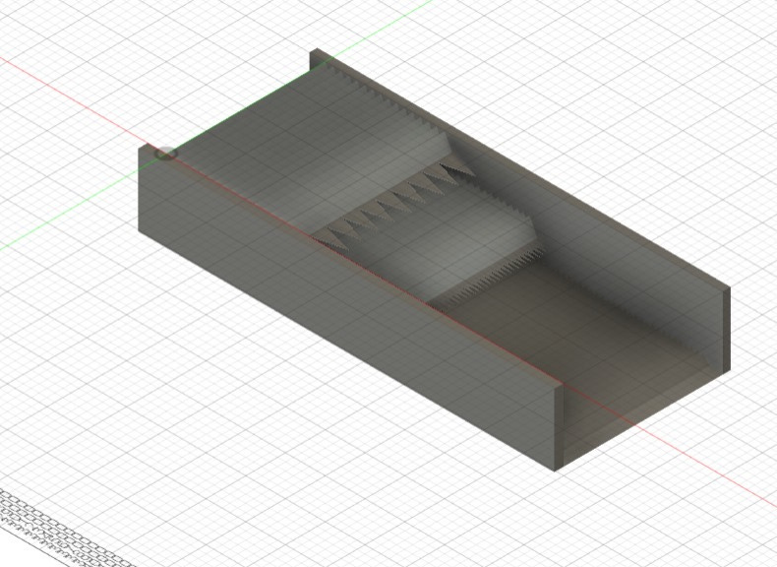
Large cleaning shoe area
The cleaning operation is accomplished in the following ways:
a) By screening out the larger particles with chaffer and sieves
b) By blowing out the lighter particles with a fan blast
c) By screening out the smaller particles in a re-cleaner.
The cleaning shoe is a critical component of the combine harvester responsible for separating clean grain from chaff and other residues after threshing. It consists of several parts, including the grain pan, chaffers, sieves, all working together to ensure maximum grain recovery with minimal loss. This process plays a vital role in maintaining grain quality and harvesting efficiency, especially across varying field conditions.

Slide 20
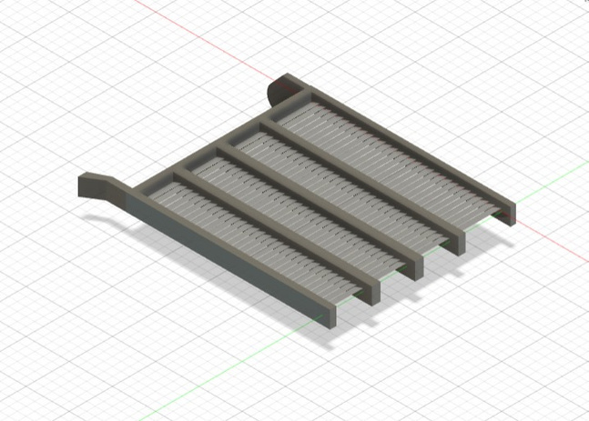

1. Straw Shaker (Preparation Pan) :
It receives the threshed mix of grain, chaff, and straw from the threshing system.
Vibrates or oscillates to move the material toward the cleaning shoe.
Starts separating heavier grains from lighter material via movement.
Helps distribute the grain evenly before it reaches the front chaffer.
Essential for initial grain separation efficiency.
Acts as the first stage of the cleaning process.
2. Sieve :
The next stage after the front chaffer, it handles a cleaner mixture.
Separates grain from larger chaff and straw particles.
Works with airflow from a fan to blow lighter material away.
Adjustable openings allow control of cleaning efficiency.
Vibrates to move material toward the rear.

Slide 21
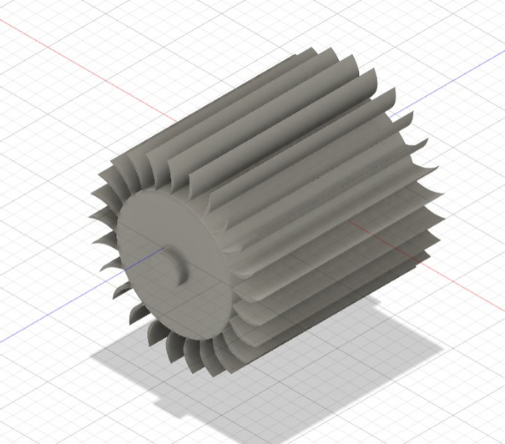
3. Cleaning Fan (Airflow System)
Blows air upward through the chaffer sieves.
Creates a floating effect, helping separate light and heavy particles.
Air pressure can be adjusted for different crop types.
Prevents grain loss by balancing air volume and sieve openings.
Works continuously as the material moves through the sieves.
Essential for removing dust, chaff, and other light waste.

Slide 22
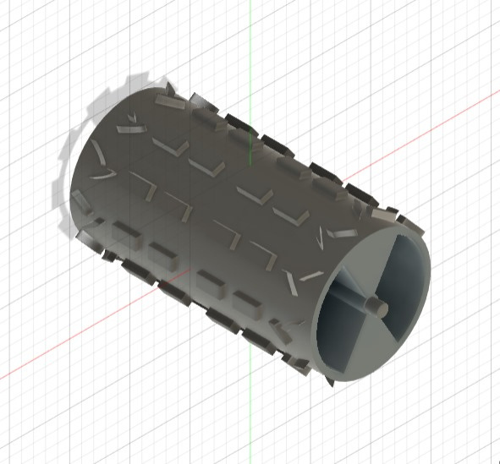
Spreader
The spreader in a combined harvester is a rear-mounted component made from high-strength steel or reinforced alloys, designed to withstand mechanical stress and environmental wear. It is structurally integrated with parts like the straw walkers, chopper, and fan system, ensuring stable and synchronized operation.
The spreader’s rotating blades, supported by durable shafts and anti-vibration mounts, are optimized for balance and efficiency.
Its materials are selected for resistance to abrasion and corrosion, and its mounting allows for minimal vibration transfer to the main frame. This component, though not involved in primary harvesting, plays a vital structural role in the harvester’s functionality.

Slide 23
Working and Applications
The spreader in a combined harvester plays a crucial role in managing crop residue after threshing and separation are complete. It helps distribute the leftover straw or chaff uniformly over the field, promoting even decomposition and reducing clumping. This aids in preparing the land for the next sowing cycle and improves soil health. The spreader's efficient distribution also prevents blockage during subsequent tillage operations.
Working of the spreader :
Receives crop residue from the straw walkers and straw chopper located ahead of it.
Rotating blades or fins scatter the residue evenly across the rear width of the harvester.
Rotation is driven by a mechanical shaft linked to the main powertrain.
Blade angle and speed can be adjusted in some models for optimal spreading based on crop type.
Works in coordination with airflow from the fan for enhanced residue lift and dispersion.
Operates continuously as part of the harvester’s end-stage cycle during field movement.

Slide 24
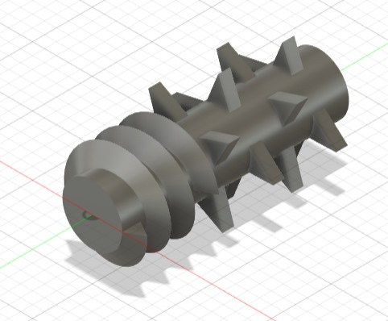
Grain Separators
The grain separator is a precision-engineered internal component of a combine harvester. It features a cylindrical structure with perforations that allow for effective separation of grains from larger crop residues. This design facilitates consistent grain flow and supports the overall efficiency of the harvesting process.
The separator's internal geometry includes helical patterns and teeth formations, which guide and agitate the incoming threshed material. These features work together to ensure even distribution, prevent clogging, and improve the purity of separated grains during high-speed operation.
The grain separator is made from high-strength steel or aluminum alloys, selected for their durability and resistance to wear. These materials enable the separator to withstand intense rotational loads and friction, ensuring reliable performance even during prolonged use in demanding agricultural environments.

Slide 25
Working
The grain separator works by receiving a mixed stream of threshed material and mechanically guiding it through perforated rotating cylinders. These allow smaller particles like grains to fall through while larger impurities are carried forward.
Operational Sequence of the Grain Separation Mechanism :
The material enters the separator from the threshing drum.
Rotating cylinders with helix or teeth patterns agitate and spread the material uniformly.
Centrifugal force and vibration help separate grains from larger residues.
Perforated surfaces allow clean grains to pass through, while unwanted material is discharged.
The process supports continuous flow for high-efficiency grain recovery.
Applications
Widely used in multi-crop harvesters for grains like rice, wheat, barley.
Ensures efficient grain separation while minimizing loss and improving overall harvest quality.
Reduces manual effort through integrated cleaning and separation in one mechanized process.
Improves grain output quality by filtering husk, debris, and broken materials efficiently.
Enables continuous high-speed operation in large-scale mechanized harvesting environments.

Slide 26
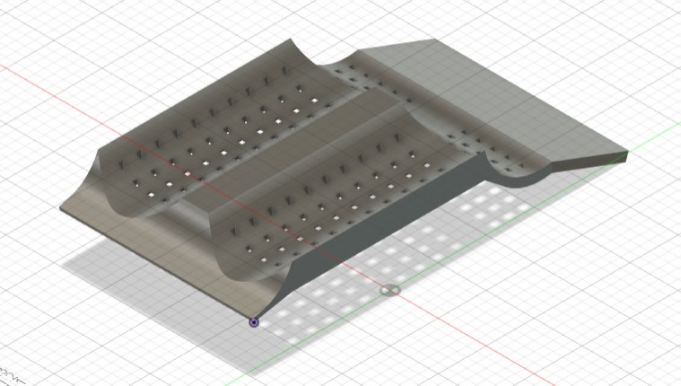
Grain Separator Frame
The grain separator frame is a foundational structural element of the combine harvester, specifically designed to house and support the rotating grain separator cylinders. Its simple yet robust rectangular design ensures correct positioning and steady operation of the internal mechanisms.
The precision-drilled pores in the frame allow debris and smaller particles to pass through, preventing material buildup and aiding in the separation process. Additionally, the curved and contoured design of the frame supports smooth material flow, reduces clogging, and ensures even distribution of the threshed material during harvesting operations.
It is typically constructed from welded high-grade steel or reinforced aluminum, offering excellent resistance to corrosion, deformation, and mechanical stress. These materials ensure long-term durability and precise support, even under heavy-duty, continuous-field operation.

Slide 27
Working
The grain separator frame functions as the backbone of the separation unit, supporting and stabilizing the movement of rotating components. It ensures proper alignment and spacing, allowing the separation process to occur smoothly without structural shifts or mechanical interference.
Operational Role of the Grain Separator Frame:
Holds and positions the rotating separator cylinders with precise alignment.
Reduces vibrations and mechanical wobble during high-speed operation.
Maintains structural integrity under the stress of rotating and separating loads.
Provides fixed mounting points for grates, covers, and guiding supports.
Ensures consistent separation by preventing misalignment and mechanical failure.
Applications
Widely used in combine harvesters to support and stabilize grain separator cylinders.
Minimizes mechanical wear by reducing vibration and structural displacement.
Essential for maintaining machine integrity during long hours of high-speed harvesting.
Provides a strong base for mounting separator grates, covers, and guiding elements.
Ensures alignment and smooth operation of internal components during continuous harvesting.

Slide 28
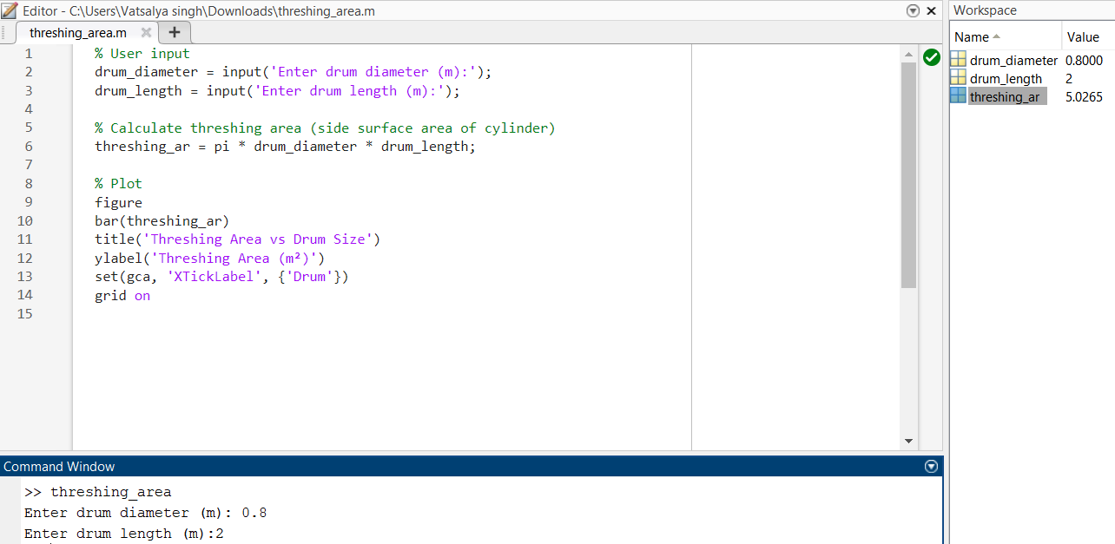
MATLAB Codes

Slide 29
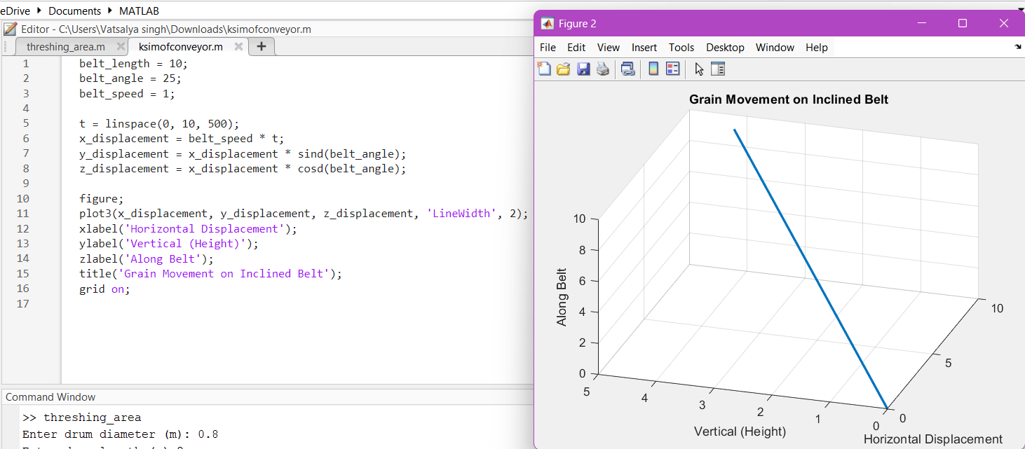

Slide 30
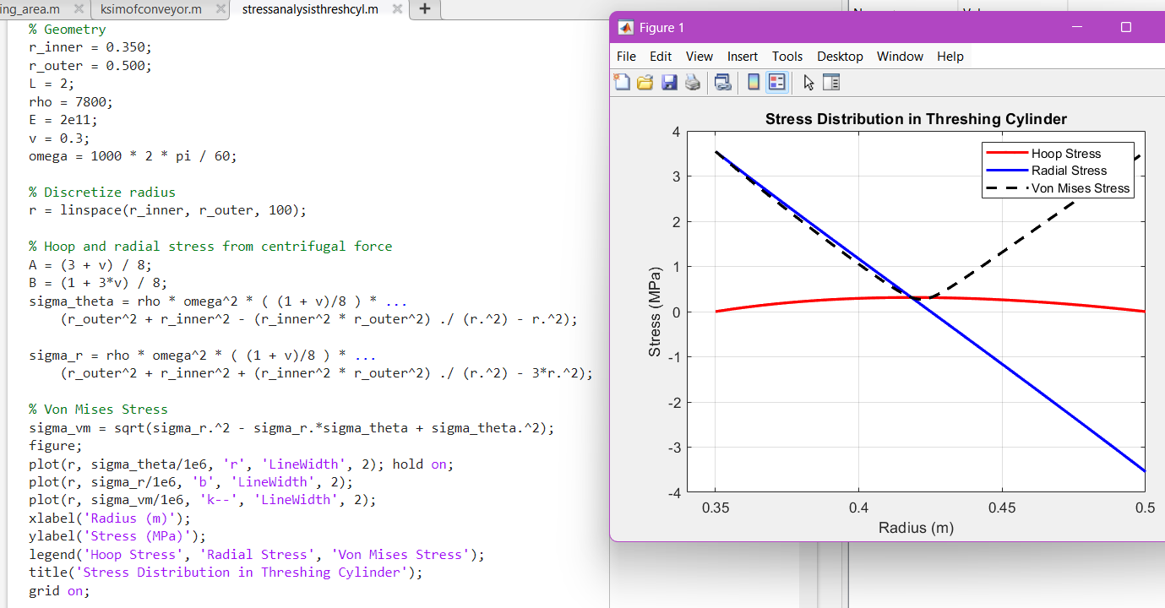
The cylinder is safe under current centrifugal loading conditions.
All stress components are well within safe limits assuming typical structural steels.

Slide 31
References
1) Zhenwei Liang, Million Eyasu Wada - Development of cleaning systems for combine harvesters: A review - 2023
2) Abdulkarim, Kazim & Abdulrahman, Kamardeen & Ahmed, Ismaila & Abdulkareem, Suleiman & Aebisi, Jeleel & Harmanto, Dani. (2017). Design of mini combined Harvester. Journal of Production Engineering. 20. 55-62. 10.24867/JPE-2017-01-055.
3) Investigation of Von - Mises Stress and Stress Concentration Factor for Cylinders with
Holes in Different Locations and Varying Pressure using Analytical Method and FEA
Mr. D. L. Pavan Kumar1 , Mr. M. Rambabu2 - 2019

